Slide 1
Hygieia

Slide 2
Hygieia - Support
Hygieia integrates widgets from story tracking, repository, build, quality, deploy and monitoring tools on a single-pane-of-glass HTML client that enables an easy access to important DevOps metrics.
Program-level dashboard helps aggregating multiple or larger teams with possibly different issue and story tracking tools, repositories and build tools.
Hygieia dashboards are customizable: users can select VersionOne or Jira for story tracking, Subversion or GitHub as repositories, Jenkins/Hudson for builds, Selenium and SonarQube for quality, uDeploy and Jenkins for deployment.
Hygieia dashboards assist in achieving process transparency and therefore help establish feedback loops that are the underlying concept of lean and DevOps.
Hygieia shows the view of the whole pipeline – from story/requirement to code deployment in production

Slide 3
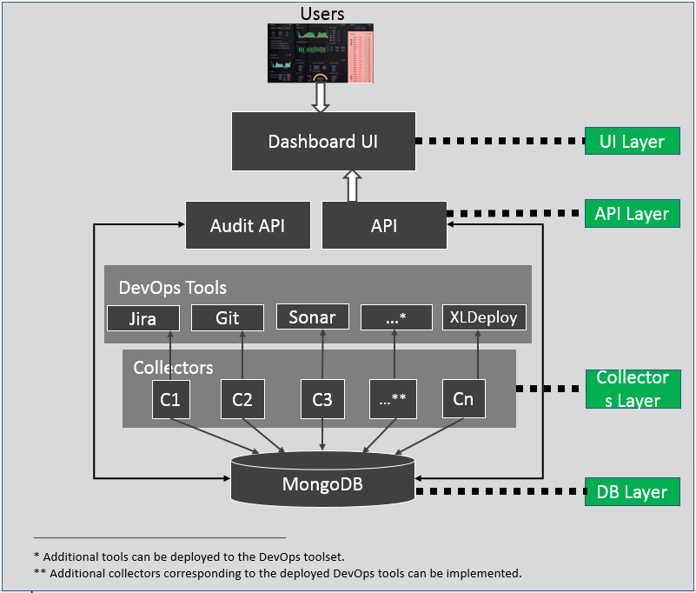
Architecture Overview

Slide 4
Dashboards
Hygieia Executive Dashboard
Portfolio - A portfolio on the dashboard is a relationship between the senior executive, the products that they manage, and the components under each product.
Products - List of all the all the products or applications under a portfolio (managed by an executive).
Components - All the components associated with a product. Each component is unit of software that is part of the larger product or application.
Team Dashboard

Slide 5
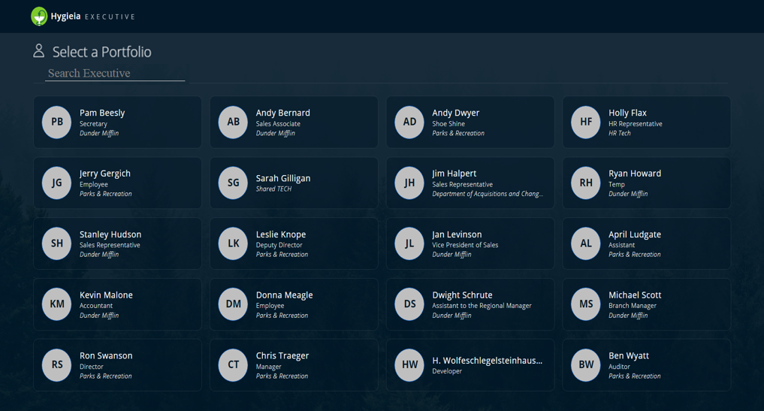
Portfolio Dashboard

Slide 6
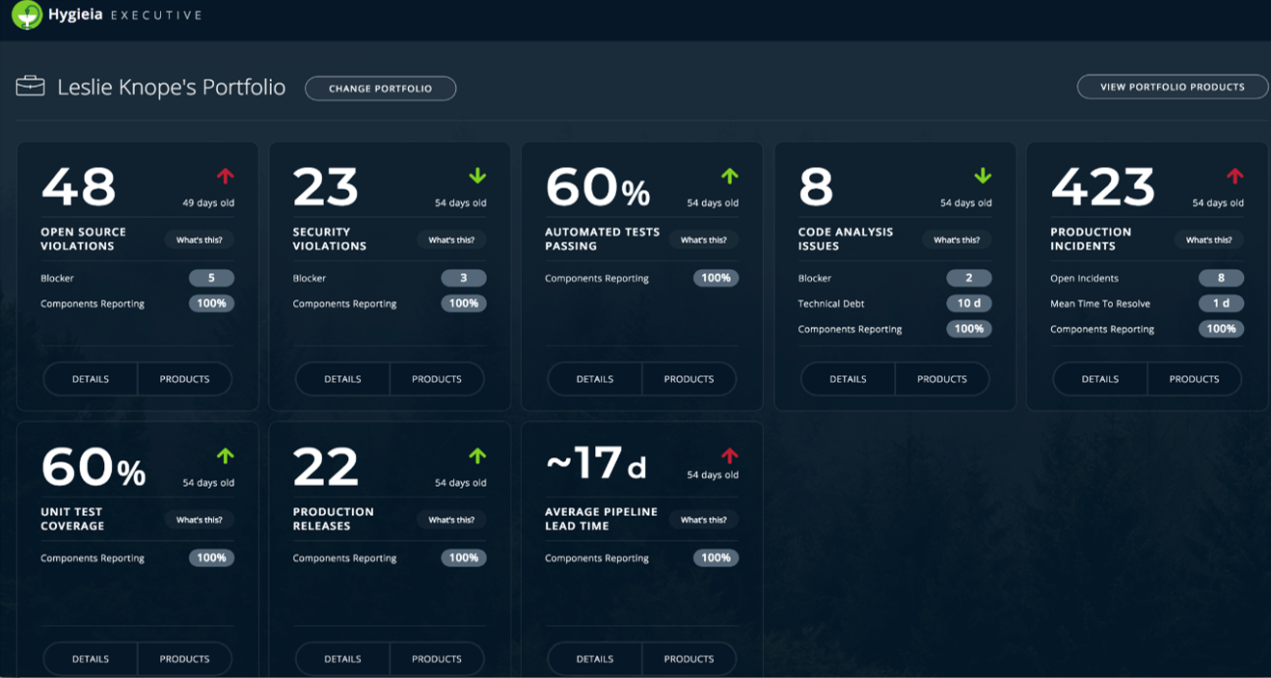
Portfolio - Metrics

Slide 7
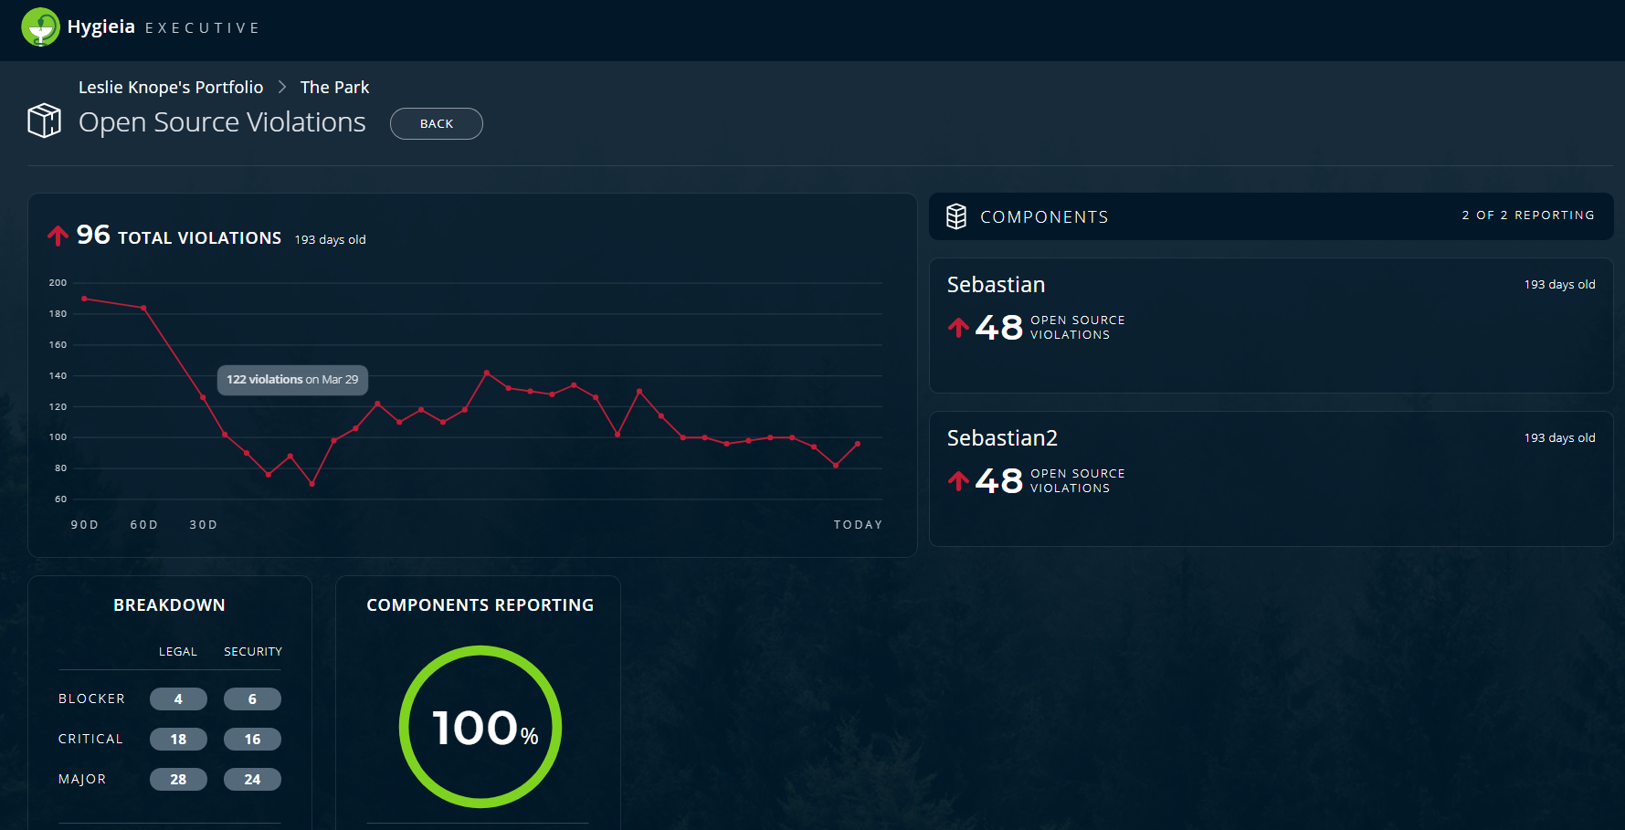
Portfolio – Component Details

Slide 8
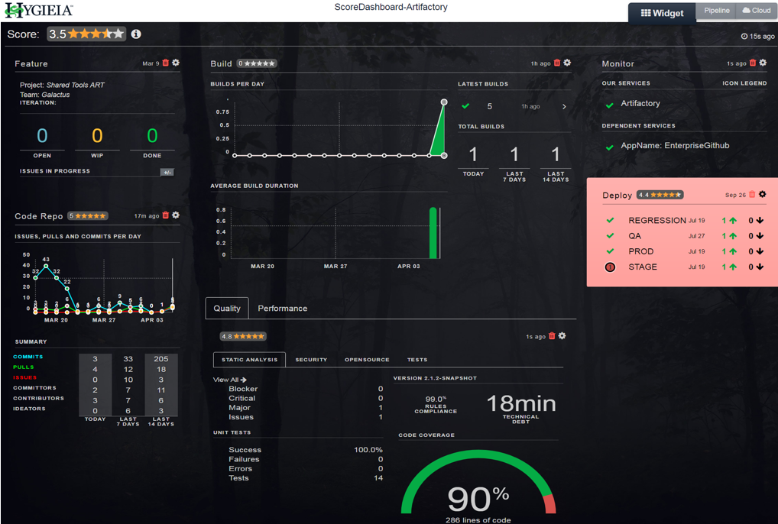
Team Level Dashboard

Slide 9
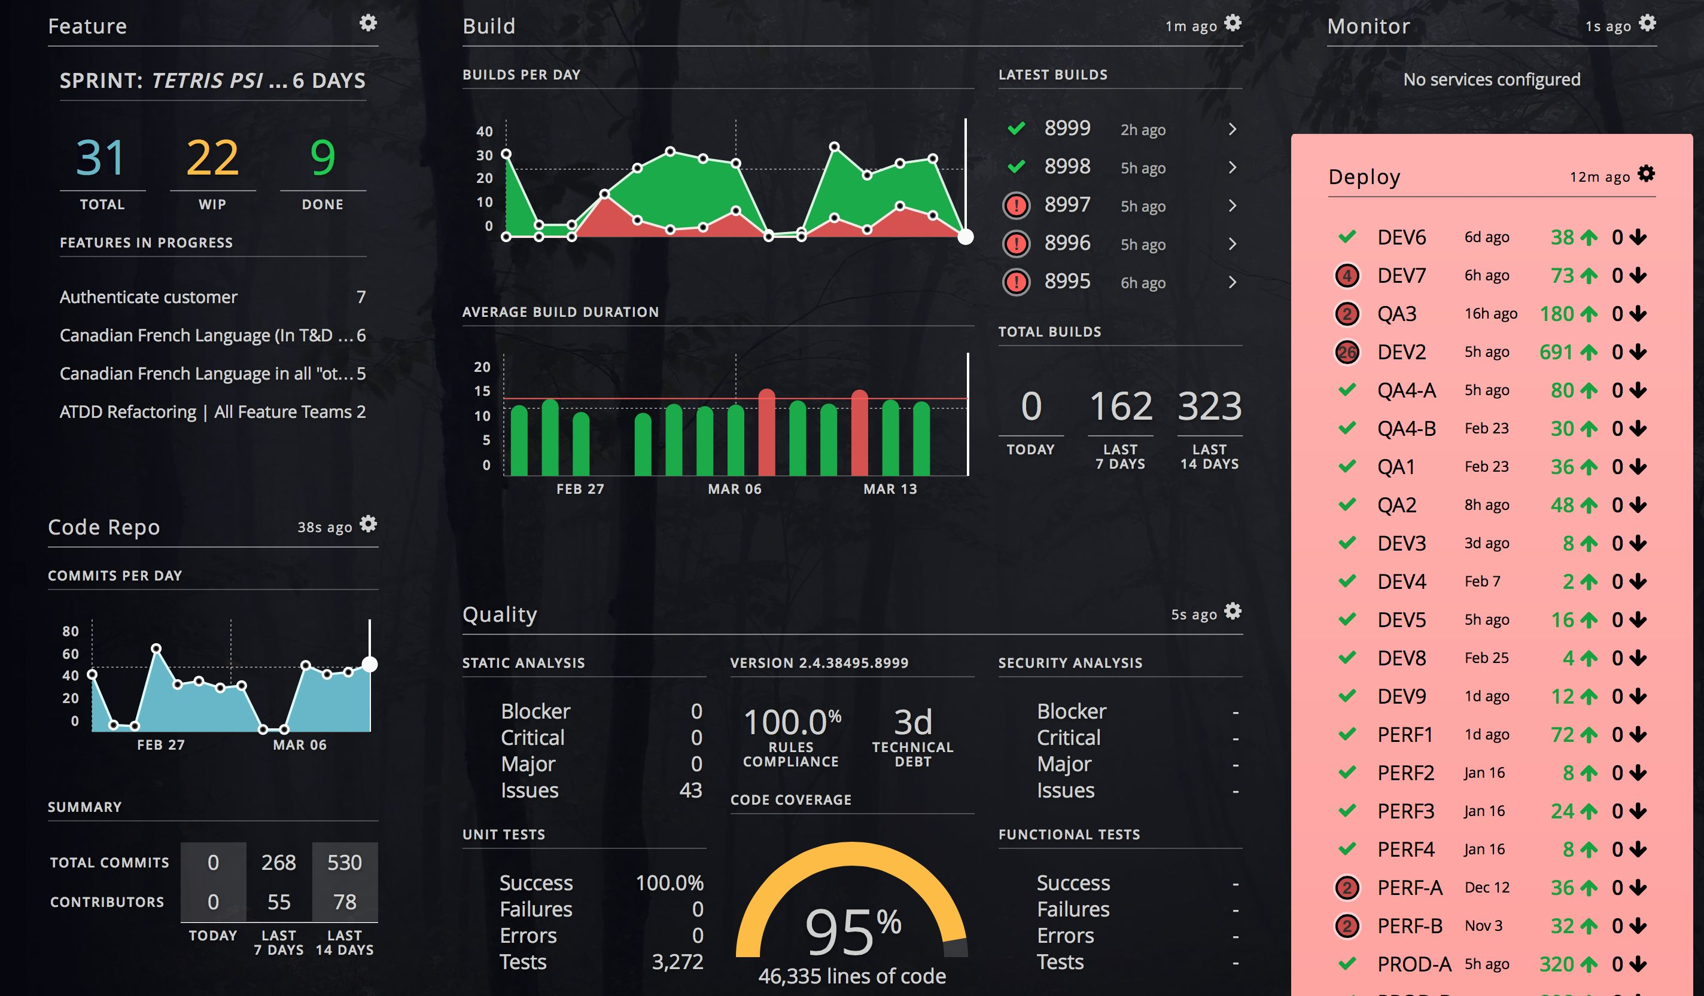
Team level dashboard

Slide 10
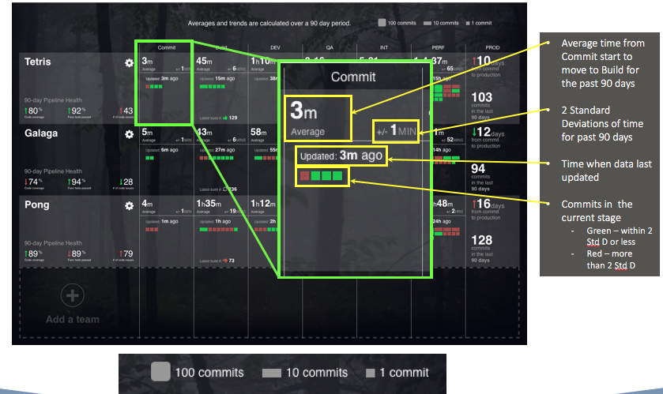
Product Dashboard - Commit

Slide 11
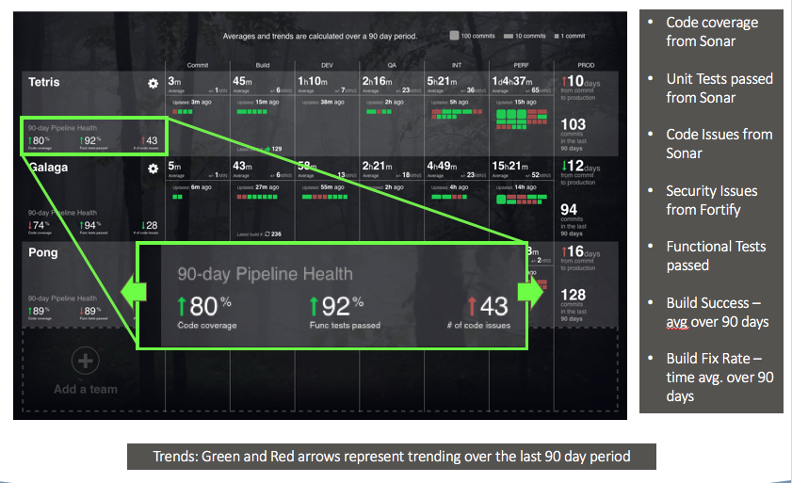
View in to Pipeline stages

Slide 12
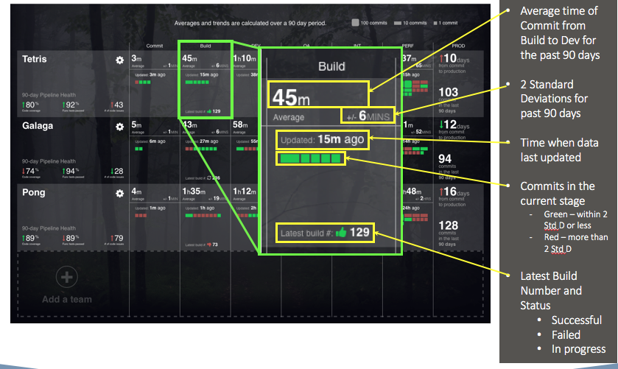
Product Dashboard – Build Stage

Slide 13
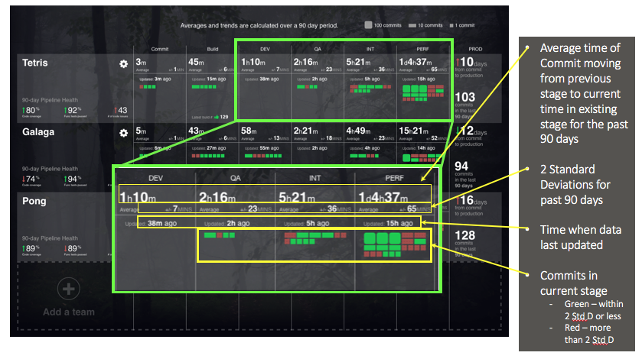
Pipeline Speed & # of Commits

Slide 14
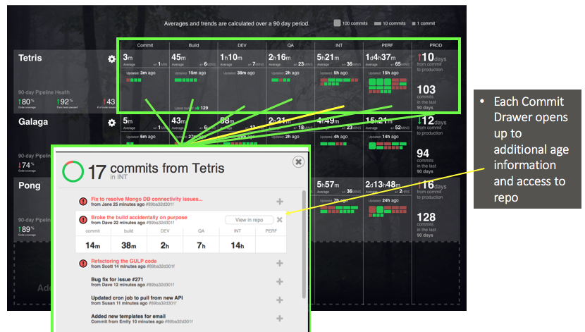
Product Dashboard – Commit Details All stages

Slide 15
Product Dashboard – Deployment Stage

Slide 16
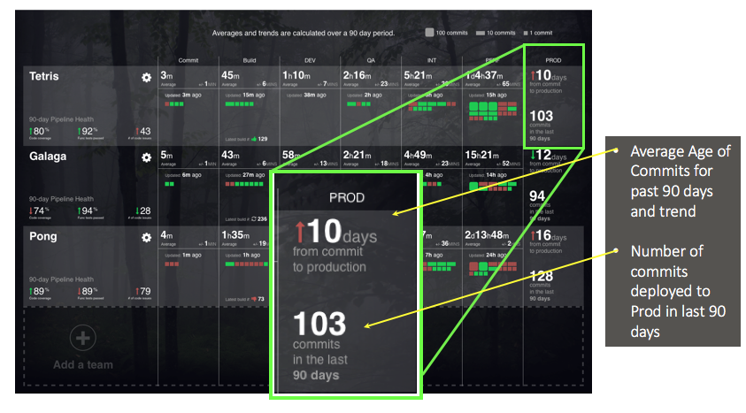
Product Dashboard – Production Stage

Slide 17
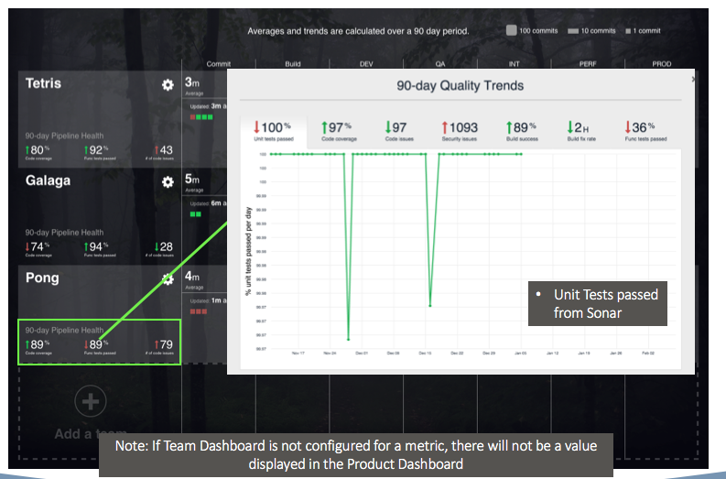
Product Dashboard – Pipeline Health

Slide 18
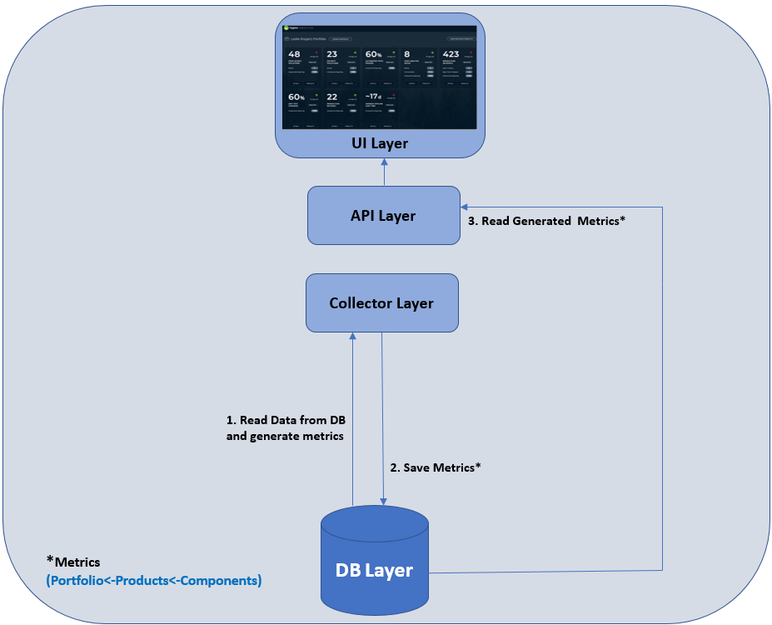
Executive Level Dashboard - Architecture

Slide 19
Executive Dashboard - Detailed

